Slide 1
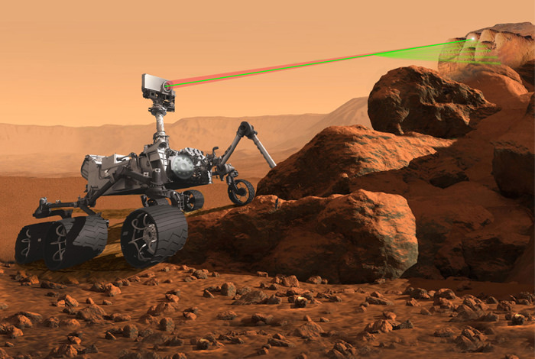
Charting a Harsh Bayesian Landscape
Andrew Arnold
University of Arizona
Advised by Natalie Klein & Casey Gibson
Wednesday, Aug 2, 2023
Graphic credit: LANL
Notes:
All the budget went to the title slide.

Slide 2
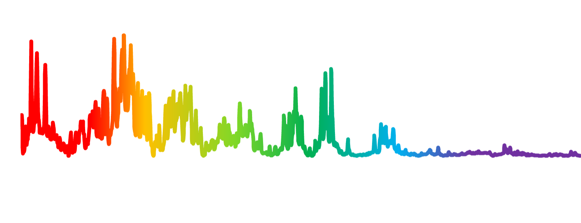

Charting a Harsh Bayesian Landscape
Andrew Arnold
University of Arizona
Advised by Natalie Klein & Casey Gibson
Wednesday, Aug 2, 2023
$$ξ$$
Graphic credit: LANL
Notes:
All the budget went to the title slide.

Slide 3
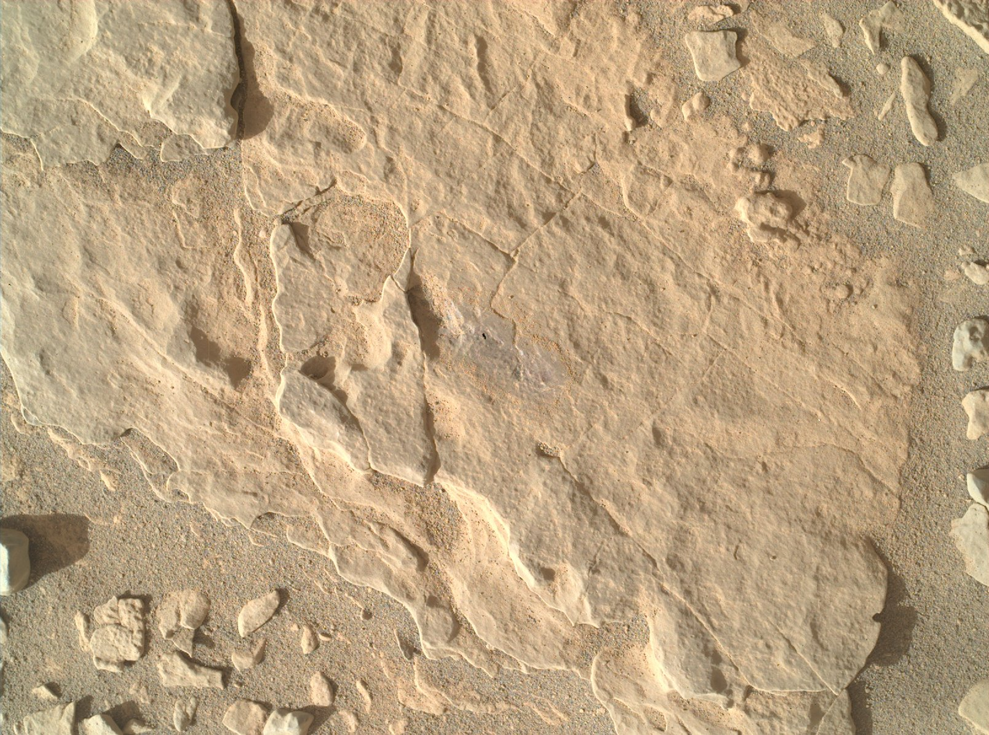

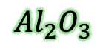


Charting a Harsh Bayesian Landscape
Andrew Arnold
University of Arizona
Advised by Natalie Klein & Casey Gibson
Wednesday, Aug 2, 2023
$$SiO_{2}$$
$$ξ$$
$$y$$
$$TiO_{2}$$
$$Al_{2}O_{3}$$
Graphic credit: LANL
Notes:
All the budget went to the title slide.

Slide 4
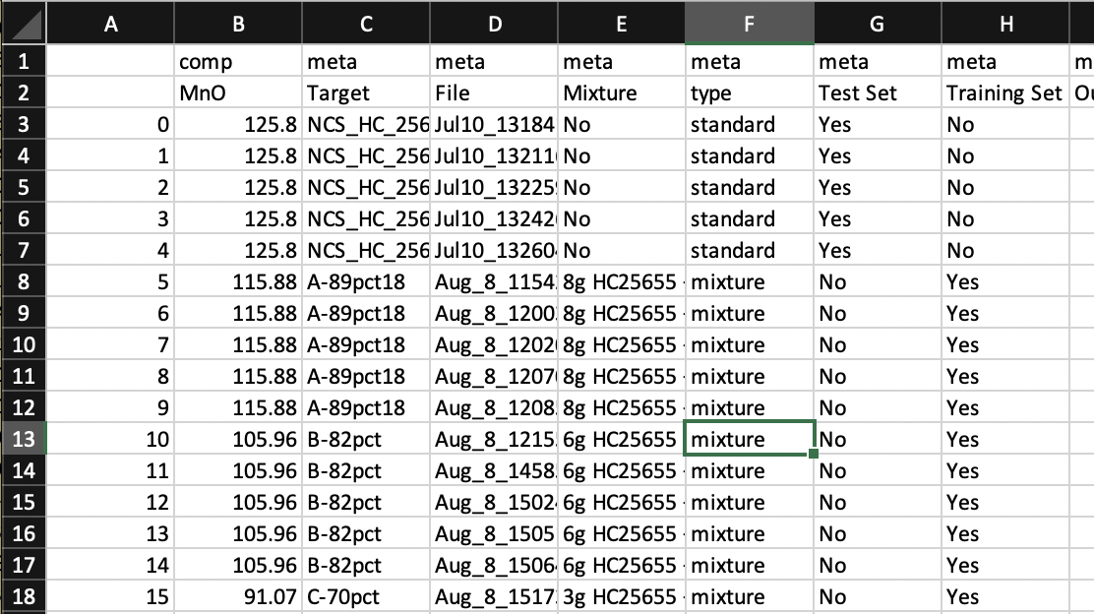





Problem Statement: Composition with UQ
Given experimental ChemCam data ${\{ξ}_{i},y_{i}$}…
$$SiO_{2}$$
$$SiO_{2}$$
$$ξ$$
$$?$$
$$y$$
…can we infer a relationship between spectra data and composition data with quantified uncertainty?
$$Al_{2}O_{3}$$
$$TiO_{2}$$
$$Al_{2}O_{3}$$
$$TiO_{2}$$
Notes:
We see the sampling of the Horseshoe MCMC is severely biased

Slide 5
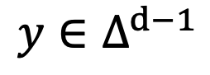


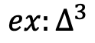

Problem Statement: Composition with UQ
$$ξ∈ℝ^{M}$$
$$y∈Δ^{d−1}$$
$${where Δ}^{d−1}=\{y∈ℝ_{+}^{d}:|y|_{1}=1\}$$
$$SiO_{2}$$
$$SiO_{2}$$
$$SiO_{2}$$
$$ξ$$
$$?$$
$$y$$
$$Al_{2}O_{3}$$
$$…$$
$$Al_{2}O_{3}$$
$$TiO_{2}$$
$$Al_{2}O_{3}$$
$$TiO_{2}$$
$$ex:Δ^{3}$$
Notes:
We see the sampling of the Horseshoe MCMC is severely biased

Slide 6
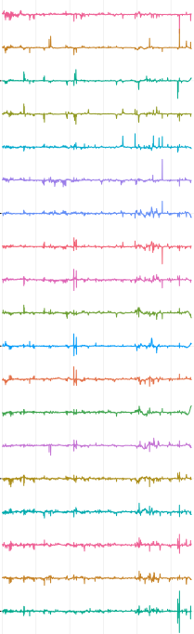
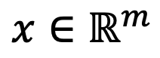
Problem Statement: Composition with UQ
$$x∈ℝ^{m}$$
$$y∈Δ^{d−1}$$
PCA
$$SiO_{2}$$
$$SiO_{2}$$
$$SiO_{2}$$
$$ξ$$
$$?$$
$$y$$
$$Al_{2}O_{3}$$
$$…$$
$$Al_{2}O_{3}$$
$$TiO_{2}$$
$$Al_{2}O_{3}$$
$$TiO_{2}$$
$$ex:Δ^{3}$$
Notes:
We see the sampling of the Horseshoe MCMC is severely biased

Slide 7
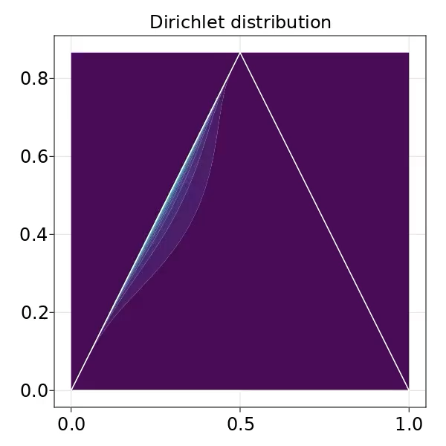
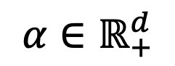
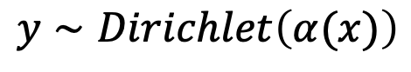
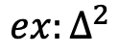
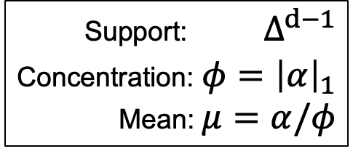

Problem Statement: Composition with UQ
$$x∈ℝ^{m}$$
$$y∼Dirichlet\left(α(x)\right)$$
$$α∈ℝ_{+}^{d}$$
Support: $Δ^{d−1}$
Concentration: $φ={\left|α\right|}_{1}$
Mean: $μ=α/φ$
PCA
$$SiO_{2}$$
$$ξ$$
$$?$$
$$TiO_{2}$$
$$etc.$$
$$…$$
$$ex:Δ^{2}$$
Notes:
We see the sampling of the Horseshoe MCMC is severely biased

Slide 8
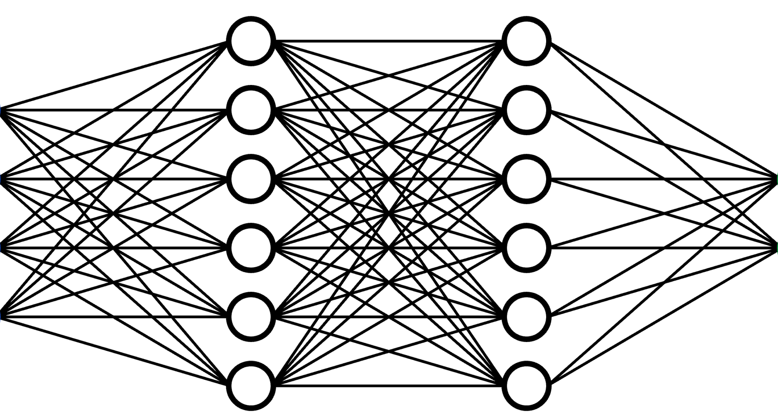
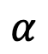
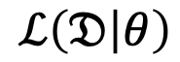
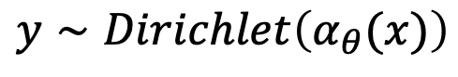

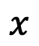
Problem Statement: Composition with UQ
$$ℒ\left(𝔇 | θ\right)$$
$$x∈ℝ^{m}$$
$$y∼Dirichlet\left(α_{θ}(x)\right)$$
$$α∈ℝ_{+}^{d}$$
PCA
$$SiO_{2}$$
$$ξ$$
$$x$$
$$α$$
$$TiO_{2}$$
$$Al_{2}O_{3}$$
$$…$$
$$θ$$
$$ex:Δ^{2}$$
Notes:
We see the sampling of the Horseshoe MCMC is severely biased

Slide 9
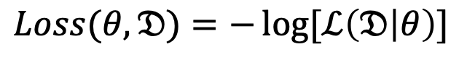
Problem Statement: Composition with UQ
$$ℒ\left(𝔇 | θ\right)$$
$$x∈ℝ^{m}$$
$$y∼Dirichlet\left(α_{θ}(x)\right)$$
$$α∈ℝ_{+}^{d}$$
$$Loss(θ,𝔇)=−\log{[ℒ\left(𝔇 | θ\right)]}$$
PCA
$$SiO_{2}$$
$$ξ$$
$$x$$
$$α$$
$$TiO_{2}$$
$$Al_{2}O_{3}$$
$$…$$
$$θ$$
$$ex:Δ^{2}$$
Notes:
We see the sampling of the Horseshoe MCMC is severely biased

Slide 10
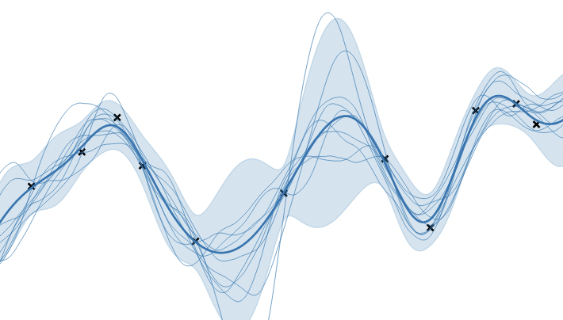
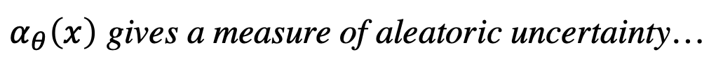
Problem Statement: Composition with UQ
$α_{θ}\left(x\right)$ gives a measure of aleatoric uncertainty…
$$…but does it give a measure of epistemic uncertainty?$$
Notes:
We see the sampling of the Horseshoe MCMC is severely biased

Slide 11
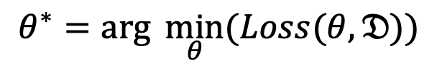
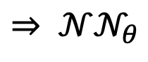
UQ: Bayesian Neural Networks
DNN:
$θ^{∗}=\arg{\min_{θ}{(Loss(θ,𝔇))}}$
$$⇒ 𝒩𝒩_{θ}$$
Notes:
Local minima correspond to modes of posterior

Slide 12
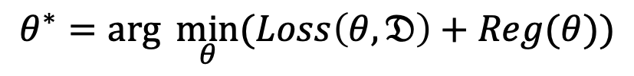
UQ: Bayesian Neural Networks
DNN:
$θ^{∗}=\arg{\min_{θ}{(Loss\left(θ,𝔇\right)+Reg(θ))}}$
$$⇒ 𝒩𝒩_{θ}$$
Notes:
Local minima correspond to modes of posterior

Slide 13
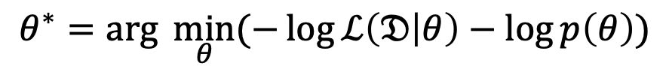
UQ: Bayesian Neural Networks
DNN:
$θ^{∗}=\arg{\min_{θ}{(−\log{ℒ\left(𝔇 | θ\right)−\log{p\left(θ\right)}})}}$
$$⇒ 𝒩𝒩_{θ}$$
Loss
Regularization
Notes:
Local minima correspond to modes of posterior

Slide 14
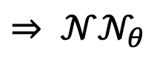
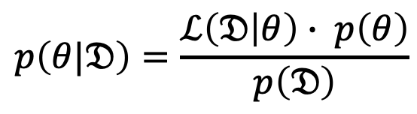
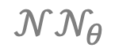
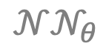


UQ: Bayesian Neural Networks
$$p\left(θ|𝔇\right)=\frac{ℒ\left(𝔇 | θ\right)∙ p\left(θ\right)}{p\left(𝔇\right)}$$
$$𝒩𝒩_{θ}$$
$$𝒩𝒩_{θ}$$
BNN:
$$⇒ 𝒩𝒩_{θ}$$
$$𝒩𝒩_{θ}$$
$$𝒩𝒩_{θ}$$
-log(□)
exp(-□)
DNN:
$θ^{∗}=\arg{\min_{θ}{(−\log{ℒ\left(𝔇 | θ\right)−\log{p\left(θ\right)}})}}$
$$⇒ 𝒩𝒩_{θ}$$
Loss
Regularization
Notes:
Local minima correspond to modes of posterior

Slide 15
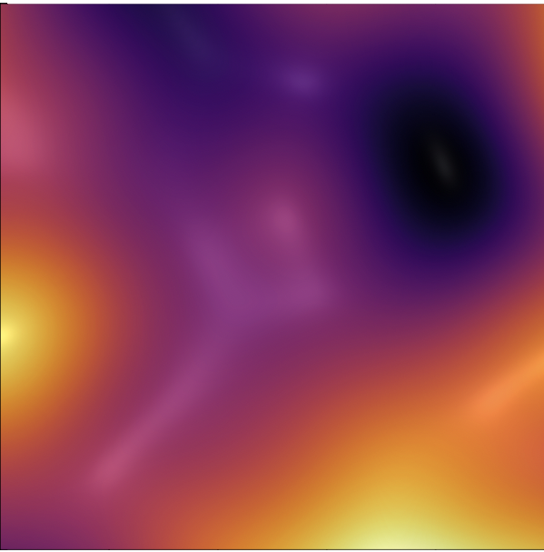
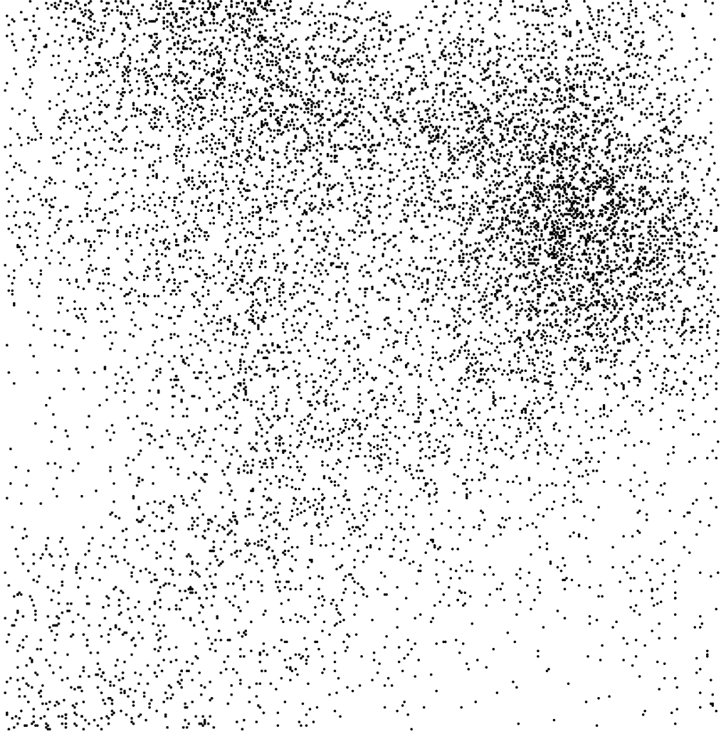
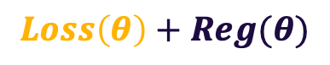

UQ: Bayesian Neural Networks
$$p\left(θ|𝔇\right)=\frac{ℒ\left(𝔇 | θ\right)∙ p\left(θ\right)}{p\left(𝔇\right)}$$
$$𝒩𝒩_{θ}$$
$$𝒩𝒩_{θ}$$
BNN:
$$⇒ 𝒩𝒩_{θ}$$
$$𝒩𝒩_{θ}$$
$$𝒩𝒩_{θ}$$
-log(□)
exp(-□)
DNN:
$θ^{∗}=\arg{\min_{θ}{(−\log{ℒ\left(𝔇 | θ\right)−\log{p\left(θ\right)}})}}$
$$⇒ 𝒩𝒩_{θ}$$
Loss
Regularization
$$Loss\left(θ\right)+Reg(θ)$$
$$Posterior\left(θ|𝔇\right)$$
Notes:
Local minima correspond to modes of posterior

Slide 16

Priors: Bayesian Neural Networks
Many different choices and ideas for priors in BNN
(see Fortuin, Priors in Bayesian Deep Learning, 2022)
For our $p(θ)$, we’ll use the Horseshoe prior:
Notes:
Local minima correspond to modes of posterior

Slide 17
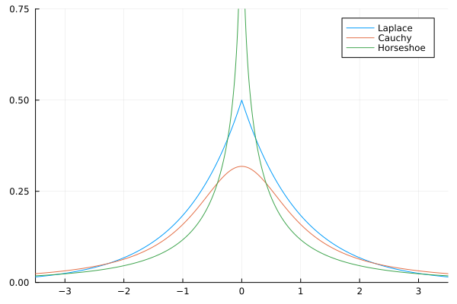
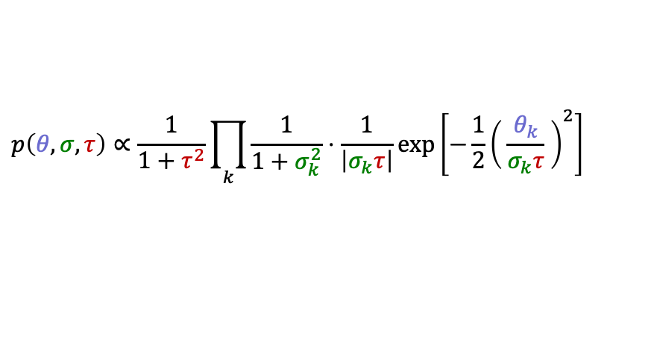
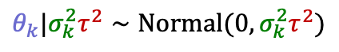


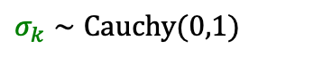
Priors: Bayesian Neural Networks
Many different choices and ideas for priors in BNN
(see Fortuin, Priors in Bayesian Deep Learning, 2022)
For our $p(θ)$, we’ll use the Horseshoe prior:
(Isotropic) Horseshoe
$$σ_{k}∼Cauchy(0,1)$$
$$Ω$$
$τ∼$ “
$$θ_{k}|σ_{k}^{2}τ^{2}∼Νormal(0,σ_{k}^{2}τ^{2})$$
$$p\left(θ, σ,τ\right)∝\frac{1}{1+τ^{2}}\prod_{k}{\frac{1}{1+σ_{k}^{2}}⋅\frac{1}{\left|σ_{k}τ\right|}\exp\left[−\frac{1}{2}{\left( \frac{θ_{k}}{σ_{k}τ} \right)}^{2}\right]}$$
Notes:
Local minima correspond to modes of posterior

Slide 18
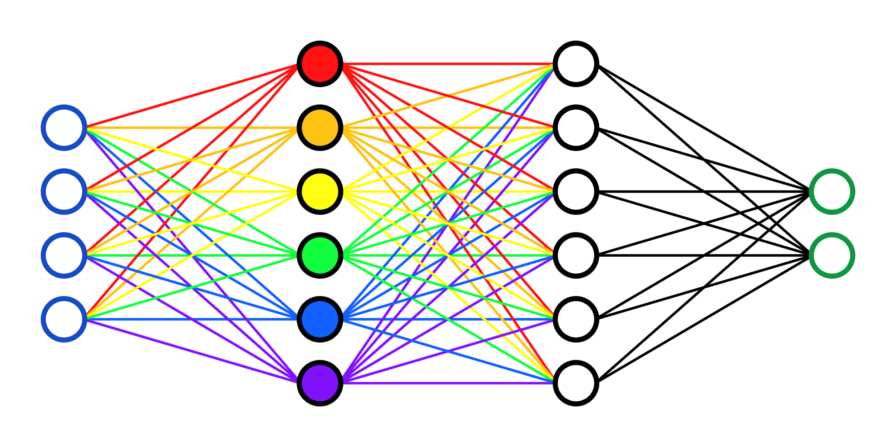
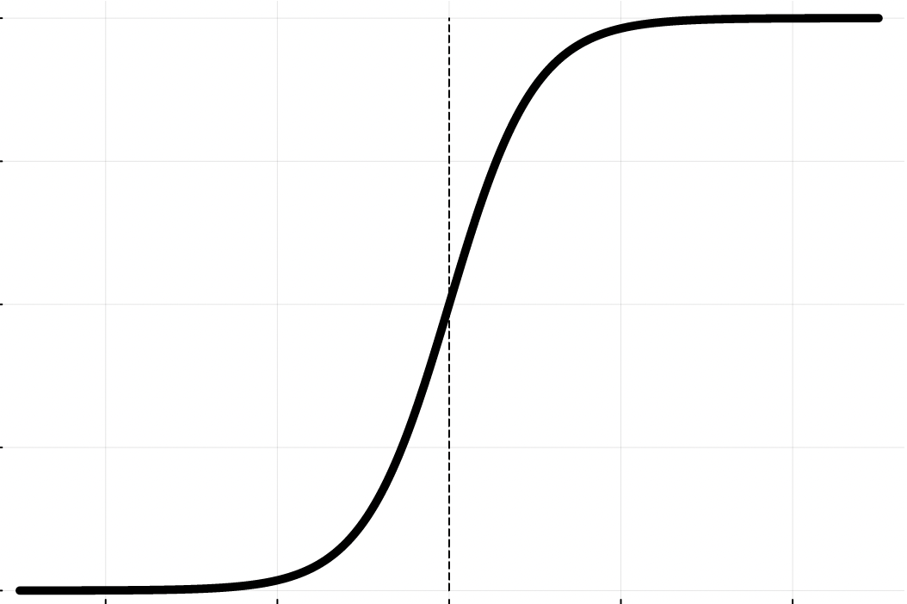
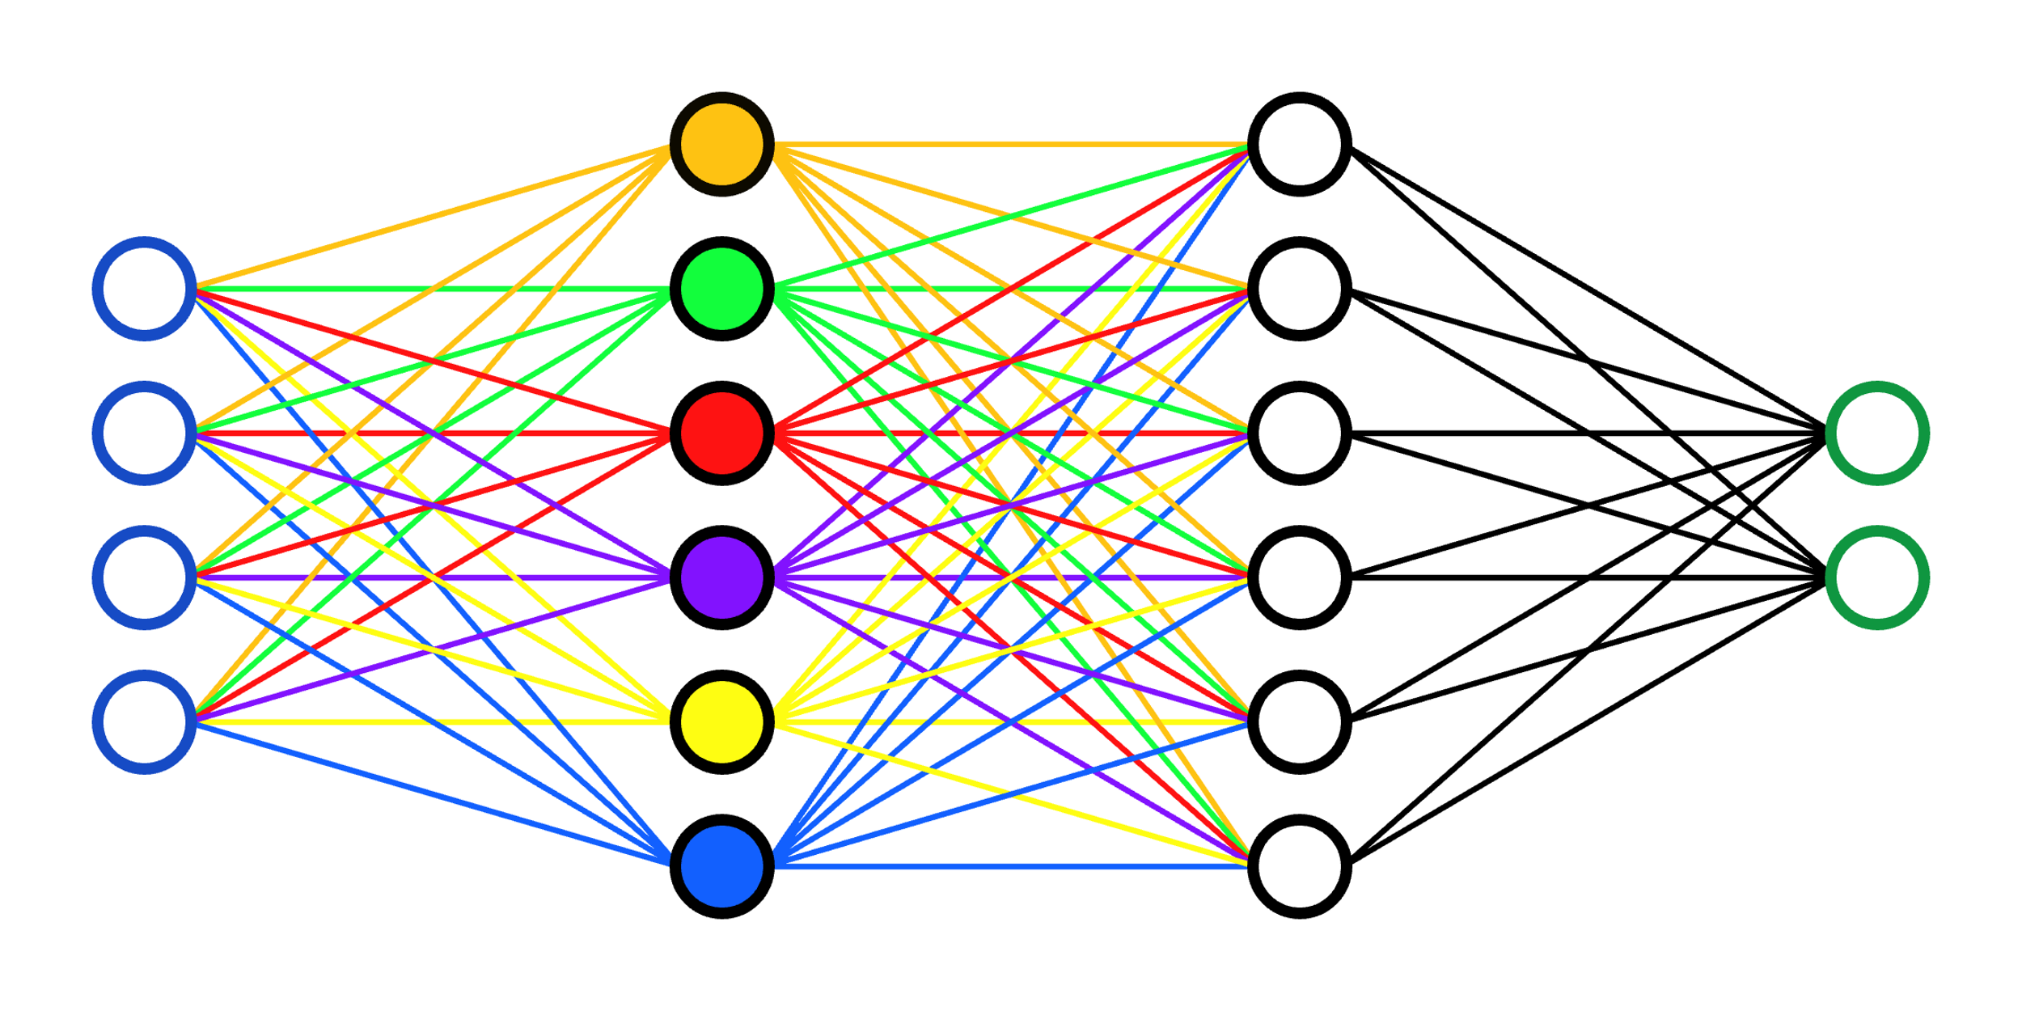
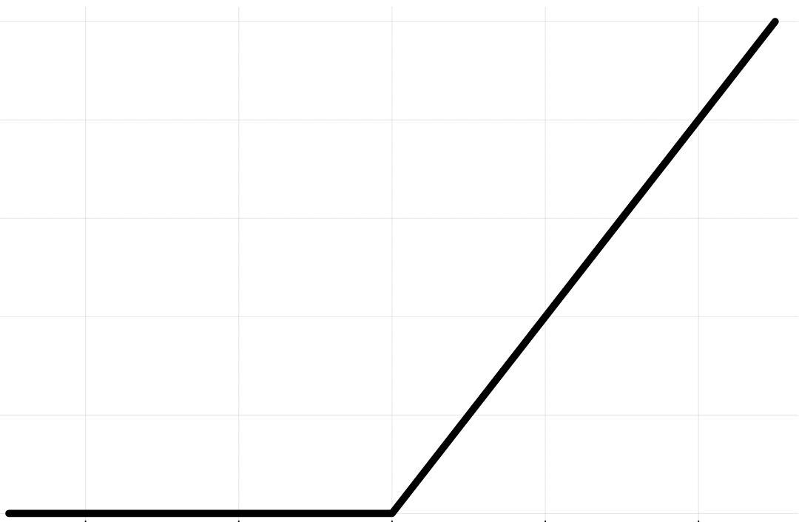
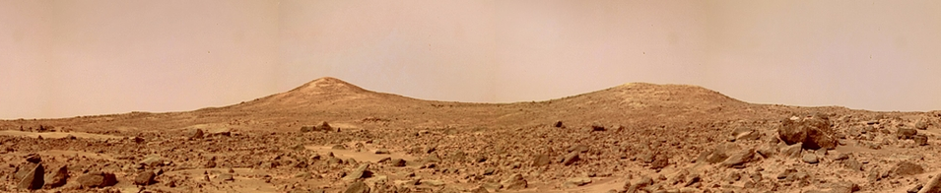
Side note: Symmetries in the Loss Landscape
Notes:
Tanh->odd symmetry, Relu-> scale invariance

Slide 19

Learning the loss/posterior landscape is great – but high-dimensional Bayesian inference is no walk in the park!
Photo credit: NASA/JPL
Notes:
Cris Moore

Slide 20
Learning the loss/posterior landscape is great – but high-dimensional Bayesian inference is no walk in the park!
MCMC
Photo credit: NASA/JPL
Notes:
Cris Moore

Slide 21

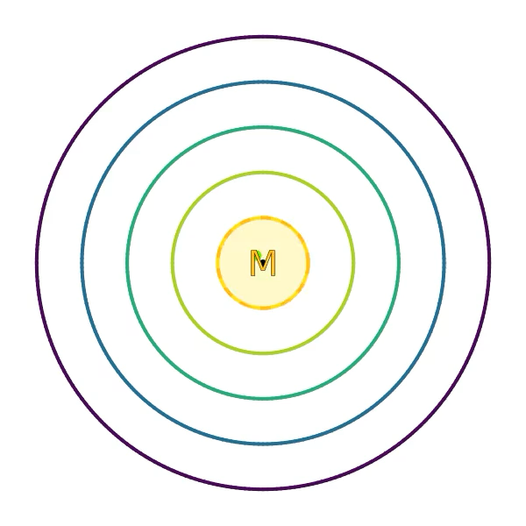

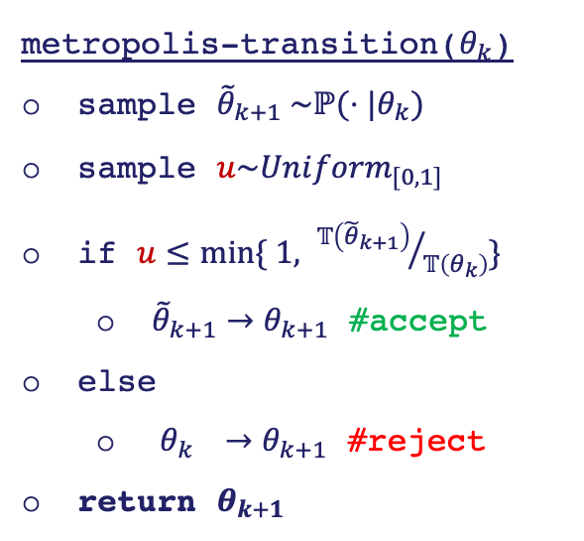
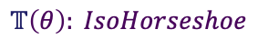
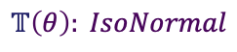


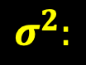
MCMC: Random Walk, $ℙ(θ|θ′)=IsoNormal(θ,σ^{2})$
metropolis-transition($θ_{k}$)
sample ${\tilde{θ}}_{k+1} \sim ℙ(⋅|θ_{k})$
sample $u\sim Uni{form}_{[0,1]}$
if $u≤min⁡\{ 1, {𝕋\left({\tilde{θ}}_{k+1}\right)}/{𝕋\left(θ_{k}\right)}\}$
${\tilde{θ}}_{k+1}→θ_{k+1}$ #accept
else
$θ_{k} →θ_{k+1}$ #reject
return $θ_{k+1}$
$$𝕋\left(θ\right): IsoHorseshoe$$
$$𝕋\left(θ\right): IsoNormal$$
$$σ^{2}:$$
Step too small,
slow to spread…
$$𝕋\left(θ\right): IsoLaplace$$
…step too BIG,
likely rejected.
Notes:
We see the sampling of the Horseshoe MCMC is severely biased

Slide 22
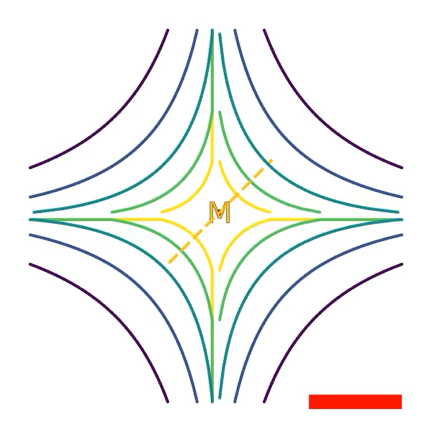
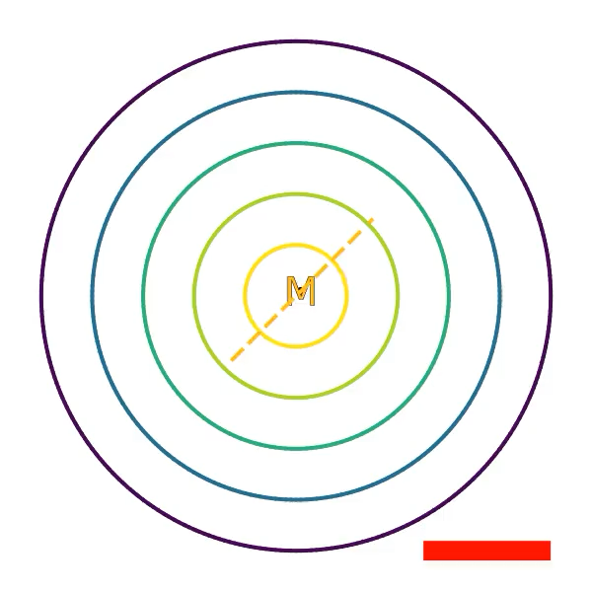

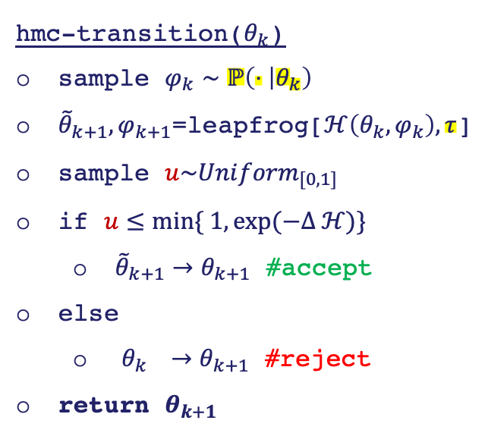

HMC: Hamiltonian MC, $ℋ\left(θ,φ\right)=−\log{(ℙ\left(φ | θ\right))}−\log{(𝕋(}θ))$
hmc-transition($θ_{k}$)
sample $φ_{k}∼ℙ\left(⋅ | θ_{k}\right)$
${\tilde{θ}}_{k+1}{,φ}_{k+1}$=leapfrog[$ℋ\left({θ_{k},φ}_{k}\right),τ$]
sample $u\sim Uni{form}_{[0,1]}$
if $u≤min⁡\{ 1,\exp{(−Δ ℋ)}\}$
${\tilde{θ}}_{k+1}→θ_{k+1}$ #accept
else
$θ_{k} →θ_{k+1}$ #reject
return $θ_{k+1}$
$$𝕋\left(θ\right): IsoHorseshoe$$
$$𝕋\left(θ\right): IsoNormal$$
Magic is in the fact that
$$ℋ=−log\left(ℙ\left(θ,φ\right)\right)$$
is conserved by dynamics!
$$𝕋\left(θ\right): IsoLaplace$$
See A Conceptual Introduction to HMC, Betancourt, 2018, for details!
Notes:
Without momentum, we’d crash right into the mode: which is what we want in a DNN

Slide 23







MCMC: Analyzing Horseshoe HMC
$$σ∼Cauchy(0,1)$$
$$Ω$$
$τ∼$ “
$$θ|σ^{2}τ^{2}∼Νormal(0,σ^{2}τ^{2})$$
$$p\left(θ, σ\right)∝\frac{1}{1+σ^{2}}⋅\frac{1}{\left|σ\right|}\exp\left[−\frac{1}{2}{\left( \frac{θ}{σ} \right)}^{2}\right]$$
$$p\left(θ_{i},θ_{j}\right)∝\prod_{k∈\{i,j\}}{Γ\left(0,\frac{θ^{2}}{2}\right)exp⁡\left(\frac{θ^{2}}{2}\right)}$$
Notes:
Tanh->odd symmetry, Relu-> scale invariance

Slide 24





MCMC: Analyzing Horseshoe HMC
$$σ∼Cauchy(0,1)$$
$$Ω$$
$τ∼$ “
$$θ|σ^{2}τ^{2}∼Νormal(0,σ^{2}τ^{2})$$
$$θ_{j}$$
$$p\left(θ, σ\right)∝\frac{1}{1+σ^{2}}⋅\frac{1}{\left|σ\right|}\exp\left[−\frac{1}{2}{\left( \frac{θ}{σ} \right)}^{2}\right]$$
$$θ_{i}$$
marginalizing over $σ$
$$p\left(θ\right)∝\int_{ℝ}{\frac{dσ}{\left|σ\right|\left(1+σ^{2}\right)}\exp\left[−{\left( \frac{θ}{σ} \right)}^{2}\right] }$$
(1) marginal
$$∝ Γ\left(0,\frac{θ^{2}}{2}\right)exp⁡\left(\frac{θ^{2}}{2}\right)$$
(1)
$$p\left(θ_{i},θ_{j}\right)∝\prod_{k∈\{i,j\}}{Γ\left(0,\frac{θ^{2}}{2}\right)exp⁡\left(\frac{θ^{2}}{2}\right)}$$
Notes:
Tanh->odd symmetry, Relu-> scale invariance

Slide 25




MCMC: Analyzing Horseshoe HMC
$$σ∼Cauchy(0,1)$$
$$Ω$$
$τ∼$ “
$$θ|σ^{2}τ^{2}∼Νormal(0,σ^{2}τ^{2})$$
$$θ_{j}$$
$$σ_{i}$$
$$p\left(θ, σ\right)∝\frac{1}{1+σ^{2}}⋅\frac{1}{\left|σ\right|}\exp\left[−\frac{1}{2}{\left( \frac{θ}{σ} \right)}^{2}\right]$$
(2)
$$θ_{i}$$
marginalizing over $σ$
$$p\left(θ\right)∝\int_{ℝ}{\frac{dσ}{\left|σ\right|\left(1+σ^{2}\right)}\exp\left[−{\left( \frac{θ}{σ} \right)}^{2}\right] }$$
(1) marginal
(2) joint
$$∝ Γ\left(0,\frac{θ^{2}}{2}\right)exp⁡\left(\frac{θ^{2}}{2}\right)$$
(1)
$$p\left(θ_{i},θ_{j}\right)∝\prod_{k∈\{i,j\}}{Γ\left(0,\frac{θ^{2}}{2}\right)exp⁡\left(\frac{θ^{2}}{2}\right)}$$
Notes:
Tanh->odd symmetry, Relu-> scale invariance

Slide 26


MCMC: Analyzing Horseshoe HMC
$$σ∼Cauchy(0,1)$$
$$Ω$$
$τ∼$ “
$$θ|σ^{2}τ^{2}∼Νormal(0,σ^{2}τ^{2})$$
$$θ_{j}$$
$$σ_{i}$$
$$p\left(θ, σ\right)∝\frac{1}{1+σ^{2}}⋅\frac{1}{\left|σ\right|}\exp\left[−\frac{1}{2}{\left( \frac{θ}{σ} \right)}^{2}\right]$$
(2)
$$θ_{i}$$
marginalizing over $σ$
$$p\left(θ\right)∝\int_{ℝ}{\frac{dσ}{\left|σ\right|\left(1+σ^{2}\right)}\exp\left[−{\left( \frac{θ}{σ} \right)}^{2}\right] }$$
(1) marginal
(2) joint
$$∝ Γ\left(0,\frac{θ^{2}}{2}\right)exp⁡\left(\frac{θ^{2}}{2}\right)$$
(1)
Change of variables (importance sampling):
$$p\left(θ_{i},θ_{j}\right)∝\prod_{k∈\{i,j\}}{Γ\left(0,\frac{θ^{2}}{2}\right)exp⁡\left(\frac{θ^{2}}{2}\right)}$$
$$\left(θ, σ\right)=ψ(θ^{∗},σ^{∗})$$
Notes:
Tanh->odd symmetry, Relu-> scale invariance

Slide 27

MCMC: Analyzing Horseshoe HMC
$$σ∼Cauchy(0,1)$$
$$Ω$$
$τ∼$ “
$$θ|σ^{2}τ^{2}∼Νormal(0,σ^{2}τ^{2})$$
$$θ_{j}$$
$$σ_{i}$$
$$p\left(θ, σ\right)∝\frac{1}{1+σ^{2}}⋅\frac{1}{\left|σ\right|}\exp\left[−\frac{1}{2}{\left( \frac{θ}{σ} \right)}^{2}\right]$$
(2)
$$θ_{i}$$
marginalizing over $σ$
$$p\left(θ\right)∝\int_{ℝ}{\frac{dσ}{\left|σ\right|\left(1+σ^{2}\right)}\exp\left[−{\left( \frac{θ}{σ} \right)}^{2}\right] }$$
(1) marginal
(2) joint
$$∝ Γ\left(0,\frac{θ^{2}}{2}\right)exp⁡\left(\frac{θ^{2}}{2}\right)$$
(1)
Change of variables (importance sampling):
$$\left(θ, σ\right)=ψ(θ^{∗},σ^{∗})$$
$$∫p_{ψ}\left(θ^{∗},σ^{∗}\right)dθ^{∗}dσ^{∗}= ∫p\left(θ, σ\right)dθdσ$$
$$= ∫p\left(ψ\left(θ^{∗},σ^{∗}\right)\right)⋅J_{ψ}dθ^{∗}dσ^{∗}$$
Notes:
Tanh->odd symmetry, Relu-> scale invariance

Slide 28
MCMC: Analyzing Horseshoe HMC
$$σ∼Cauchy(0,1)$$
$$Ω$$
$τ∼$ “
$$θ|σ^{2}τ^{2}∼Νormal(0,σ^{2}τ^{2})$$
$$θ_{j}$$
$$σ_{i}$$
$$p\left(θ, σ\right)∝\frac{1}{1+σ^{2}}⋅\frac{1}{\left|σ\right|}\exp\left[−\frac{1}{2}{\left( \frac{θ}{σ} \right)}^{2}\right]$$
(2)
$$θ_{i}$$
marginalizing over $σ$
$$p\left(θ\right)∝\int_{ℝ}{\frac{dσ}{\left|σ\right|\left(1+σ^{2}\right)}\exp\left[−{\left( \frac{θ}{σ} \right)}^{2}\right] }$$
(1) marginal
(2) joint
$$∝ Γ\left(0,\frac{θ^{2}}{2}\right)exp⁡\left(\frac{θ^{2}}{2}\right)$$
(1)
Change of variables (importance sampling):
$$p\left(θ_{i},θ_{j}\right)∝\prod_{k∈\{i,j\}}{Γ\left(0,\frac{θ^{2}}{2}\right)exp⁡\left(\frac{θ^{2}}{2}\right)}$$
$$\left(θ, σ\right)=ψ(θ^{∗},σ^{∗})$$
$$∫p_{ψ}\left(θ^{∗},σ^{∗}\right)dθ^{∗}dσ^{∗}= ∫p\left(θ, σ\right)dθdσ$$
$$= ∫p\left(ψ\left(θ^{∗},σ^{∗}\right)\right)⋅J_{ψ}dθ^{∗}dσ^{∗}$$
Notes:
Tanh->odd symmetry, Relu-> scale invariance

Slide 29







MCMC: Analyzing Horseshoe HMC
$$σ∼Cauchy(0,1)$$
$$Ω$$
$τ∼$ “
$$θ|σ^{2}τ^{2}∼Νormal(0,σ^{2}τ^{2})$$
$$θ_{j}$$
$$σ_{i}$$
$$p\left(θ, σ\right)∝\frac{1}{1+σ^{2}}⋅\frac{1}{\left|σ\right|}\exp\left[−\frac{1}{2}{\left( \frac{θ}{σ} \right)}^{2}\right]$$
(2)
$$θ_{i}$$
standard dev. $σ$
$$→$$
precision $σ^{∗}$
(1) marginal
(2) joint
$${σ=1/σ}^{∗}$$
Change of variables (importance sampling):
$$p\left(θ, σ^{∗}\right)∝\frac{1}{1+{(1/σ^{∗})}^{2}}⋅\frac{{(1/σ^{∗})}^{2}}{\left|1/σ^{∗}\right|}\exp\left[−\frac{1}{2}{\left( \frac{θ}{1/σ^{∗}} \right)}^{2}\right]$$
$$p\left(θ_{i},θ_{j}\right)∝\prod_{k∈\{i,j\}}{Γ\left(0,\frac{θ^{2}}{2}\right)exp⁡\left(\frac{θ^{2}}{2}\right)}$$
$$\left(θ, σ\right)=ψ(θ^{∗},σ^{∗})$$
$$∫p_{ψ}\left(θ^{∗},σ^{∗}\right)dθ^{∗}dσ^{∗}= ∫p\left(θ, σ\right)dθdσ$$
$$p\left(θ, σ^{∗}\right)∝\frac{\left|σ^{∗}\right|}{1+{σ^{∗}}^{2}}\exp\left[−\frac{{\left(θσ^{∗}\right)}^{2}}{2}\right]$$
$$= ∫p\left(ψ\left(θ^{∗},σ^{∗}\right)\right)⋅J_{ψ}dθ^{∗}dσ^{∗}$$
(3)
Notes:
Tanh->odd symmetry, Relu-> scale invariance

Slide 30






MCMC: Analyzing Horseshoe HMC
$$σ∼Cauchy(0,1)$$
$$Ω$$
$τ∼$ “
$$θ|σ^{2}τ^{2}∼Νormal(0,σ^{2}τ^{2})$$
$$θ_{j}$$
$$σ_{i}$$
$$σ_{i}^{∗}$$
$$θ_{i}$$
(1) marginal
(2) joint
(3) precision joint
$$p\left(θ_{i},θ_{j}\right)∝\prod_{k∈\{i,j\}}{Γ\left(0,\frac{θ^{2}}{2}\right)exp⁡\left(\frac{θ^{2}}{2}\right)}$$
(4) tilted-form joint
exponential tilt
(3) precision-form joint
$p\left(θ, σ^{∗}\right)∝\frac{e^{σ^{∗∗}}}{1+e^{{2σ}^{∗∗}}}⋅$ $coshθ^{∗}e^{σ^{∗∗}}$
$⋅exp\left[−\frac{{\left(sinhθ^{∗}e^{σ^{∗∗}}\right)}^{2}}{2}\right]$
$$θ=sinhθ^{∗}$$
$$p\left(θ, σ^{∗}\right)∝\frac{\left|σ^{∗}\right|}{1+{σ^{∗}}^{2}}\exp\left[−\frac{{\left(θσ^{∗}\right)}^{2}}{2}\right]$$
$$σ^{∗}=\exp{σ^{∗∗}}$$
Notes:
Tanh->odd symmetry, Relu-> scale invariance

Slide 31





MCMC: Analyzing Horseshoe HMC
$$σ∼Cauchy(0,1)$$
$$Ω$$
$τ∼$ “
$$θ|σ^{2}τ^{2}∼Νormal(0,σ^{2}τ^{2})$$
$$θ_{j}$$
$$σ_{i}$$
$$σ_{i}^{∗}$$
$$σ_{i}^{∗∗}$$
$$θ_{i}$$
$$θ_{i}^{∗}$$
(1) marginal
(2) joint
(3) precision joint
(4) tilted joint
$$p\left(θ_{i},θ_{j}\right)∝\prod_{k∈\{i,j\}}{Γ\left(0,\frac{θ^{2}}{2}\right)exp⁡\left(\frac{θ^{2}}{2}\right)}$$
(4) tilted-form joint
exponential tilt
(3) precision-form joint
$p\left(θ, σ^{∗}\right)∝\frac{e^{σ^{∗∗}}}{1+e^{{2σ}^{∗∗}}}⋅$ $coshθ^{∗}e^{σ^{∗∗}}$
$⋅exp\left[−\frac{{\left(sinhθ^{∗}e^{σ^{∗∗}}\right)}^{2}}{2}\right]$
$$θ=sinhθ^{∗}$$
$$p\left(θ, σ^{∗}\right)∝\frac{\left|σ^{∗}\right|}{1+{σ^{∗}}^{2}}\exp\left[−\frac{{\left(θσ^{∗}\right)}^{2}}{2}\right]$$
$$σ^{∗}=\exp{σ^{∗∗}}$$
(3)
Notes:
Tanh->odd symmetry, Relu-> scale invariance

Slide 32




MCMC: Analyzing Horseshoe HMC
$$σ∼Cauchy(0,1)$$
$$Ω$$
$τ∼$ “
$$θ|σ^{2}τ^{2}∼Νormal(0,σ^{2}τ^{2})$$
$$θ_{j}$$
$$σ_{i}$$
$$σ_{i}^{∗}$$
$$σ_{i}^{∗∗}$$
$$θ_{i}$$
$$θ_{i}^{∗}$$
(1) marginal
(1) marginal
(2) joint
(2) joint
(3) precision joint
(3) precision joint
(4) tilted joint
Analytical CDF vs. Empirical CDF from HMC chain after 500 proposals:
K-S = 0.0482
$$p\left(θ_{i},θ_{j}\right)∝\prod_{k∈\{i,j\}}{Γ\left(0,\frac{θ^{2}}{2}\right)exp⁡\left(\frac{θ^{2}}{2}\right)}$$
K-S = 0.0456
K-S = 0.0468
Notes:
Tanh->odd symmetry, Relu-> scale invariance

Slide 33



MCMC: Analyzing Horseshoe HMC
$$σ∼Cauchy(0,1)$$
$$Ω$$
$τ∼$ “
$$θ|σ^{2}τ^{2}∼Νormal(0,σ^{2}τ^{2})$$
$$θ_{j}$$
$$σ_{i}$$
$$σ_{i}^{∗}$$
$$σ_{i}^{∗∗}$$
$$θ_{i}$$
$$θ_{i}^{∗}$$
(1) marginal
(1) marginal
(2) joint
(2) joint
(3) precision joint
(3) precision joint
(4) tilted joint
$$p\left(θ_{i},θ_{j}\right)∝\prod_{k∈\{i,j\}}{Γ\left(0,\frac{θ^{2}}{2}\right)exp⁡\left(\frac{θ^{2}}{2}\right)}$$
Log-scale histograms from HMC chain after 3000 proposals:
Notes:
Tanh->odd symmetry, Relu-> scale invariance

Slide 34



MCMC: Analyzing Horseshoe HMC
$$σ∼Cauchy(0,1)$$
$$Ω$$
$τ∼$ “
$$θ|σ^{2}τ^{2}∼Νormal(0,σ^{2}τ^{2})$$
$$θ_{j}$$
$$σ_{i}$$
$$σ_{i}^{∗}$$
$$σ_{i}^{∗∗}$$
$$θ_{i}$$
$$θ_{i}^{∗}$$
(1) marginal
(1) marginal
(2) joint
(2) joint
(3) precision joint
(3) precision joint
(4) tilted joint
$$p\left(θ_{i},θ_{j}\right)∝\prod_{k∈\{i,j\}}{Γ\left(0,\frac{θ^{2}}{2}\right)exp⁡\left(\frac{θ^{2}}{2}\right)}$$
Log-scale histograms from HMC chain after 3000 proposals:
Range $≈$ 130
Range $≈$ 86
Range $≈$ 3,260
Notes:
Tanh->odd symmetry, Relu-> scale invariance

Slide 35

MCMC: Analyzing Horseshoe HMC
$$σ∼Cauchy(0,1)$$
$$Ω$$
$τ∼$ “
$$θ|σ^{2}τ^{2}∼Νormal(0,σ^{2}τ^{2})$$
$$θ_{j}$$
$$σ_{i}$$
$$σ_{i}^{∗}$$
$$σ_{i}^{∗∗}$$
$$θ_{i}$$
$$θ_{i}^{∗}$$
(1) marginal
(1) marginal
(2) joint
(2) joint
(3) precision joint
(3) precision joint
(4) tilted joint
Range $≈$ 374,077
$$p\left(θ_{i},θ_{j}\right)∝\prod_{k∈\{i,j\}}{Γ\left(0,\frac{θ^{2}}{2}\right)exp⁡\left(\frac{θ^{2}}{2}\right)}$$
Log-scale histograms from HMC chain after 3000 proposals:
Range $≈$ 130
Range $≈$ 86
Range $≈$ 3,260
Notes:
Tanh->odd symmetry, Relu-> scale invariance

Slide 36




DNN: Bagging some peaks
one layer
5 nodes
relu activation
exp link
SiO₃ predictions
$−\log\left[ℒ\left(𝔇 | θ\right)\right]/N$
Fraction
Train:
-23.930
Val:
-20.238
withheld
three layers
“
$−\log\left[ℒ\left(𝔇 | θ\right)\right]/N$
Fraction
Train:
-23.996
Val:
-24.287
Samples
Notes:
Interestingly, looks *like* epistemic uncertainty! This shows exactly why this problem is interesting: tighter fit, but similar Loss!

Slide 37




BNN: Early forays
$$p\left(θ_{i},θ_{j}\right)∝\prod_{k∈\{i,j\}}{Γ\left(0,\frac{θ^{2}}{2}\right)exp⁡\left(\frac{θ^{2}}{2}\right)}$$
Notes:
Tanh->odd symmetry, Relu-> scale invariance

Slide 38


BNN: Early forays
$$τ$$
$$p\left(θ_{i},θ_{j}\right)∝\prod_{k∈\{i,j\}}{Γ\left(0,\frac{θ^{2}}{2}\right)exp⁡\left(\frac{θ^{2}}{2}\right)}$$
Notes:
Tanh->odd symmetry, Relu-> scale invariance

Slide 39

Questions?
Ongoing work:
Run parallel (~1200 chains) of MCMC for larger and larger networks; use Horseshoe to learn optimal sparse network

Slide 40


Preliminary: Bayesian Linear Regression
Data
$$𝔇={\left\{x,y\right\}}_{i=1,…,N}$$
Model
$$y=wx+b$$
See: https://gregorygundersen.com/blog/2020/02/04/bayesian-linear-regression/
Notes:
Data, want to fit a model.

Slide 41


Preliminary: Bayesian Linear Regression
Data
$$𝔇={\left\{x,y\right\}}_{i=1,…,N}$$
Model
$$y=wx+b$$
Ordinary Least Squares:
$$w^{∗},b^{∗}=\arg{\min_{w,b}{S_{𝔇}(w},b})$$
$$σ^{2}≈\frac{S_{𝔇}(w^{∗},b^{∗}\text{)}}{N}$$
See: https://gregorygundersen.com/blog/2020/02/04/bayesian-linear-regression/
Notes:
Frequentist approach, minimize least squares. Variance estimated in the frequentist way.

Slide 42
Preliminary: Bayesian Linear Regression
Data
$$𝔇={\left\{x,y\right\}}_{i=1,…,N}$$
Model
$$y=wx+b$$
Bayes
$$p\left(w,b,σ^{2}|𝔇\right)∝ ℒ\left(𝔇|w,b,σ^{2}\right)∙p\left(w,b,σ^{2}\right)$$
See: https://gregorygundersen.com/blog/2020/02/04/bayesian-linear-regression/
Notes:
Bayesian Alternative

Slide 43

Preliminary: Bayesian Linear Regression
Data
$$𝔇={\left\{x,y\right\}}_{i=1,…,N}$$
Model
$$y=wx+b$$
Bayes
$$p\left(w,b,σ^{2}|𝔇\right)∝ ℒ\left(𝔇|w,b,σ^{2}\right)∙p\left(w,b,σ^{2}\right)$$
Likelihood
$$ℒ\left(𝔇|w,b,σ^{2}\right)=Ν(y|wx+b,σ^{2})$$
See: https://gregorygundersen.com/blog/2020/02/04/bayesian-linear-regression/
Notes:
Likelihood corresponds with ordinary least squares: Maximum likelihood estimate

Slide 44



Preliminary: Bayesian Linear Regression
Data
$$𝔇={\left\{x,y\right\}}_{i=1,…,N}$$
Model
$$y=wx+b$$
Bayes
$$p\left(w,b,σ^{2}|𝔇\right)∝ ℒ\left(𝔇|w,b,σ^{2}\right)∙p\left(w,b,σ^{2}\right)$$
Likelihood
$$ℒ\left(𝔇|w,b,σ^{2}\right)=Ν(y|wx+b,σ^{2})$$
$$p\left(w|σ^{2}\right)=Ν(w|0,σ^{2}Λ_{w})$$
Priors
$$p\left(b|σ^{2}\right)=Ν(b|0,σ^{2}Λ_{b})$$
$$p\left(σ^{2}\right)=InvGamma(σ^{2}|α,β)$$
See: https://gregorygundersen.com/blog/2020/02/04/bayesian-linear-regression/
Notes:
Have to choose some priors, so we pick priors that make our life easy

Slide 45
Preliminary: Bayesian Linear Regression
Data
$$𝔇={\left\{x,y\right\}}_{i=1,…,N}$$
Model
$$y=wx+b$$
Bayes
$$p\left(w,b,σ^{2}|𝔇\right)∝ ℒ\left(𝔇|w,b,σ^{2}\right)∙p\left(w,b,σ^{2}\right)$$
Likelihood
$$ℒ\left(𝔇|w,b,σ^{2}\right)=Ν(y|wx+b,σ^{2})$$
$$p\left(w|σ^{2}\right)=Ν(w|0,σ^{2}Λ_{w})$$
Priors
$$p\left(b|σ^{2}\right)=Ν(b|0,σ^{2}Λ_{b})$$
$$p\left(σ^{2}\right)=InvGamma(σ^{2}|α,β)$$
See: https://gregorygundersen.com/blog/2020/02/04/bayesian-linear-regression/
Notes:
We get a distribution out with distinctive bowtie shaped envelope

Slide 46

Preliminary: Bayesian Linear Regression
Data
$$𝔇={\left\{x,y\right\}}_{i=1,…,N}$$
Model
$$y=wx+b$$
Bayes
$$p\left(w,b,σ^{2}|𝔇\right)∝ ℒ\left(𝔇|w,b,σ^{2}\right)∙p\left(w,b,σ^{2}\right)$$
Likelihood
$$ℒ\left(𝔇|w,b,σ^{2}\right)=Ν(y|wx+b,σ^{2})$$
$$p\left(w|σ^{2}\right)=Ν(w|0,σ^{2}Λ_{w})$$
Priors
$$p\left(b|σ^{2}\right)=Ν(b|0,σ^{2}Λ_{b})$$
$$p\left(σ^{2}\right)=InvGamma(σ^{2}|α,β)$$
See: https://gregorygundersen.com/blog/2020/02/04/bayesian-linear-regression/
Notes:
As we collect more data, epistemic uncertainty decreases despite the aleatoric variance

Slide 47
UQ: Bayesian Neural Networks
$$p\left(θ|𝔇\right)=\frac{ℒ\left(𝔇 | θ\right)∙ p\left(θ\right)}{p\left(𝔇\right)}$$
BNN:
Notes:
BNN is the same idea as Bayesian regression, applied to the parameters of a neural network

Slide 48
UQ: Bayesian Neural Networks
$$p\left(θ|𝔇\right)=\frac{ℒ\left(𝔇 | θ\right)∙ p\left(θ\right)}{p\left(𝔇\right)}$$
$$𝒩𝒩_{θ}$$
$$𝒩𝒩_{θ}$$
BNN:
$$⇒ 𝒩𝒩_{θ}$$
$$𝒩𝒩_{θ}$$
$$𝒩𝒩_{θ}$$
Notes:
BNN is the same idea as Bayesian regression, applied to the parameters of a neural network

Slide 49
UQ: Bayesian Neural Networks
$$p\left(θ|𝔇\right)=\frac{ℒ\left(𝔇 | θ\right)∙ p\left(θ\right)}{p\left(𝔇\right)}$$
$$𝒩𝒩_{θ}$$
$$𝒩𝒩_{θ}$$
BNN:
$$⇒ 𝒩𝒩_{θ}$$
$$𝒩𝒩_{θ}$$
$$𝒩𝒩_{θ}$$
-log(□)
exp(-□)
DNN:
$θ^{∗}=\arg{\min_{θ}{(−\log{ℒ\left(𝔇 | θ\right)−\log{p\left(θ\right)}}+\log{p(𝔇}))}}$
Notes:
Rough correspondence between BNN and DNN

Slide 50
UQ: Bayesian Neural Networks
$$p\left(θ|𝔇\right)=\frac{ℒ\left(𝔇 | θ\right)∙ p\left(θ\right)}{p\left(𝔇\right)}$$
$$𝒩𝒩_{θ}$$
$$𝒩𝒩_{θ}$$
BNN:
$$⇒ 𝒩𝒩_{θ}$$
$$𝒩𝒩_{θ}$$
$$𝒩𝒩_{θ}$$
-log(□)
exp(-□)
constant
DNN:
$θ^{∗}=\arg{\min_{θ}{(−\log{ℒ\left(𝔇 | θ\right)−\log{p\left(θ\right)}}+\log{p(𝔇}))}}$
Notes:
Last term is a constant, doesn’t affect arg min

Slide 51
UQ: Bayesian Neural Networks
$$p\left(θ|𝔇\right)=\frac{ℒ\left(𝔇 | θ\right)∙ p\left(θ\right)}{p\left(𝔇\right)}$$
$$𝒩𝒩_{θ}$$
$$𝒩𝒩_{θ}$$
BNN:
$$⇒ 𝒩𝒩_{θ}$$
$$𝒩𝒩_{θ}$$
$$𝒩𝒩_{θ}$$
-log(□)
exp(-□)
DNN:
$θ^{∗}=\arg{\min_{θ}{(−\log{ℒ\left(𝔇 | θ\right)−\log{p\left(θ\right)}})}}$
$$⇒ 𝒩𝒩_{θ}$$

Slide 52
UQ: Bayesian Neural Networks
$$p\left(θ|𝔇\right)=\frac{ℒ\left(𝔇 | θ\right)∙ p\left(θ\right)}{p\left(𝔇\right)}$$
$$𝒩𝒩_{θ}$$
$$𝒩𝒩_{θ}$$
BNN:
$$⇒ 𝒩𝒩_{θ}$$
$$𝒩𝒩_{θ}$$
$$𝒩𝒩_{θ}$$
-log(□)
exp(-□)
DNN:
$θ^{∗}=\arg{\min_{θ}{(−\log{ℒ\left(𝔇 | θ\right)−\log{p\left(θ\right)}})}}$
$$⇒ 𝒩𝒩_{θ}$$
Loss
Regularization
Notes:
If No Regularization, we can treat last term as a constant—uniform priors

Slide 53
UQ: Bayesian Neural Networks
$$p\left(θ|𝔇\right)=\frac{ℒ\left(𝔇 | θ\right)∙ p\left(θ\right)}{p\left(𝔇\right)}$$
$$𝒩𝒩_{θ}$$
$$𝒩𝒩_{θ}$$
BNN:
$$⇒ 𝒩𝒩_{θ}$$
$$𝒩𝒩_{θ}$$
$$𝒩𝒩_{θ}$$
-log(□)
exp(-□)
DNN:
$θ^{∗}=\arg{\min_{θ}{(−\log{ℒ\left(𝔇 | θ\right)−\log{p\left(θ\right)}})}}$
$$⇒ 𝒩𝒩_{θ}$$
Loss
Regularization
Prior | Regularization
Normal | L2 (Ridge regression)
Laplace | L1 (LASSO)
Horseshoe | Nope!
Notes:
Sometimes there’s an analog regularization for a prior, but not necessarily (Horseshoe is unbounded)

Slide 54
UQ: Bayesian Neural Networks
$$p\left(θ|𝔇\right)=\frac{ℒ\left(𝔇 | θ\right)∙ p\left(θ\right)}{p\left(𝔇\right)}$$
$$𝒩𝒩_{θ}$$
$$𝒩𝒩_{θ}$$
BNN:
$$⇒ 𝒩𝒩_{θ}$$
$$𝒩𝒩_{θ}$$
$$𝒩𝒩_{θ}$$
Perform inference to obtain posterior of $𝒩𝒩$ parameters $θ$.
How?

Slide 55
UQ: Bayesian Neural Networks
$$p\left(θ|𝔇\right)=\frac{ℒ\left(𝔇 | θ\right)∙ p\left(θ\right)}{p\left(𝔇\right)}$$
$$𝒩𝒩_{θ}$$
$$𝒩𝒩_{θ}$$
BNN:
$$⇒ 𝒩𝒩_{θ}$$
$$𝒩𝒩_{θ}$$
$$𝒩𝒩_{θ}$$
Perform inference to obtain posterior of $𝒩𝒩$ parameters $θ$.
How?
Variational Inference
Markov Chain Monte Carlo
+ Cheaper
- Expensive!
or
- Less expressive
+ Non-parametric
Notes:
VI: good to capture a few modes, variance is not necessarily accurate
MCMC: really costly!

Slide 56


So: What are BNNs good for?
Out-of-distribution uncertainty
Global characterization
Advanced regularization
$$p\left(θ|𝔇\right)$$

Slide 57




So: What are BNNs good for?
Horseshoe prior
$$p\left(θ|σ^{2}\right)=Ν(θ|0,σ^{2}Λ)$$
Out-of-distribution uncertainty
Global characterization
Advanced regularization
→ → →
$$p\left(σ^{2}\right)=HalfCauchy(σ^{2}|0,1)$$
$$p\left(θ|𝔇\right)$$
Carvalho, et al. Handling Sparsity via the Horseshoe
Notes:
Horseshoe: non-zero probability mass on zero, heavy tails
Student-t: Cauchy

Slide 58
So: What are BNNs good for?
Horseshoe prior
$$p\left(θ|σ^{2}\right)=Ν(θ|0,σ^{2}Λ)$$
Out-of-distribution uncertainty
Global characterization
Advanced regularization
→ → →
$$p\left(σ^{2}\right)=HalfCauchy(σ^{2}|0,1)$$
Non-zero probability mass at 0!
$$p\left(θ|𝔇\right)$$
Carvalho, et al. Handling Sparsity via the Horseshoe
Notes:
Horseshoe: non-zero probability mass on zero, heavy tails
Student-t: Cauchy

Slide 59
So: What are BNNs good for?
Horseshoe prior
$$p\left(θ|σ^{2}\right)=Ν(θ|0,σ^{2}Λ)$$
Out-of-distribution uncertainty
Global characterization
Advanced regularization
→ → →
$$p\left(σ^{2}\right)=HalfCauchy(σ^{2}|0,1)$$
Non-zero probability mass at 0!
Fat tails (Cauchy-like)!
$$p\left(θ|𝔇\right)$$
Carvalho, et al. Handling Sparsity via the Horseshoe
Notes:
Horseshoe: non-zero probability mass on zero, heavy tails
Student-t: Cauchy

